Slide 1
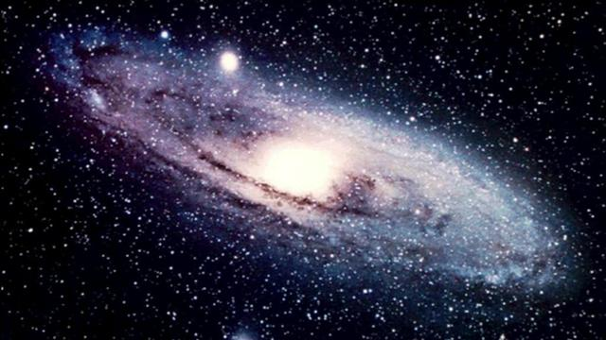
Planets and space science
Catlin Gross
Earth and Space Science
Grade Level: 8
March 7, 2012

Slide 2
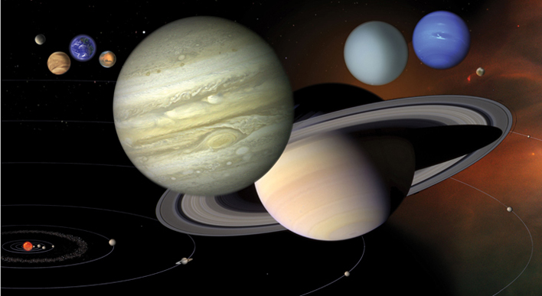
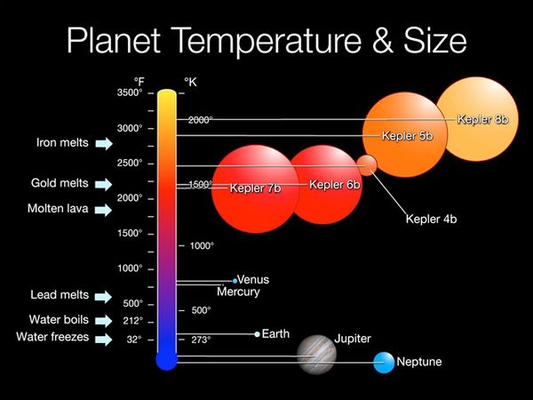
What You Will Learn
Sizes of planets in accordance with one another
Characteristics of the planets in the Milky Way

Slide 3
Before Our Journey, Know these Terms…
Galaxy- a large system of stars held together by mutual gravitation and isolated from similar systems by vast regions of space.
Light Year- unit by which intergalactic distances are measured. (A light year is 5,865,696,000,000 miles .)
Planet-Also called major planet; any of the eight large heavenly bodies revolving about the sun and shining by reflected light
Dwarf Planet -a spherical body revolving about the sun, similar to a planet but not large enough to gravitationally clear its orbital region of most or all other celestial bodies.

Slide 4
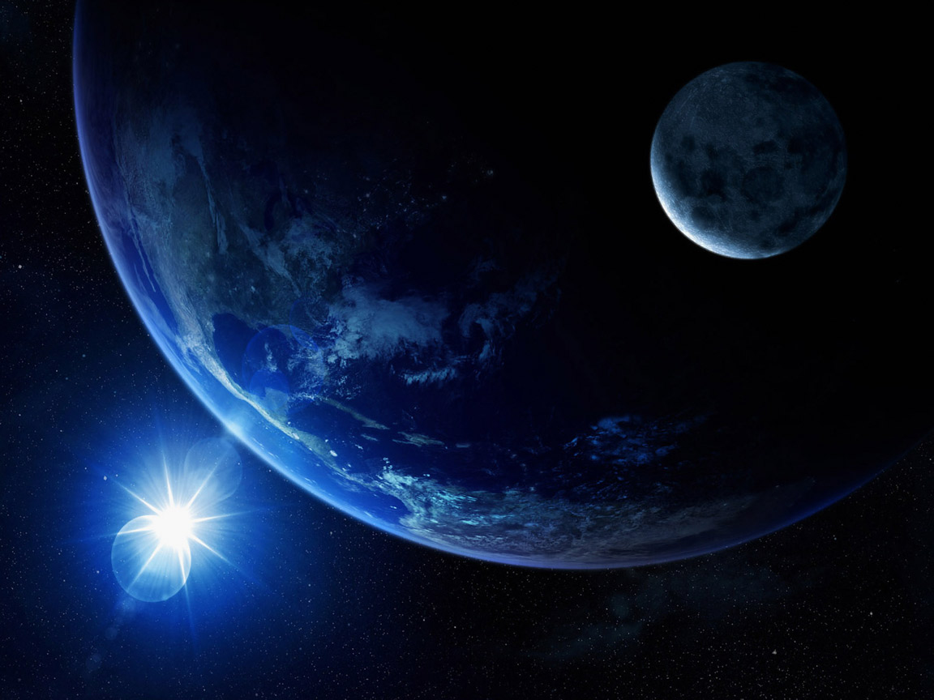


What can you tell me about Outer Space?
What’s it like? Are other planets like Earth? Do aliens really exist on other planets?
Let us journey into Outer Space…

Slide 5
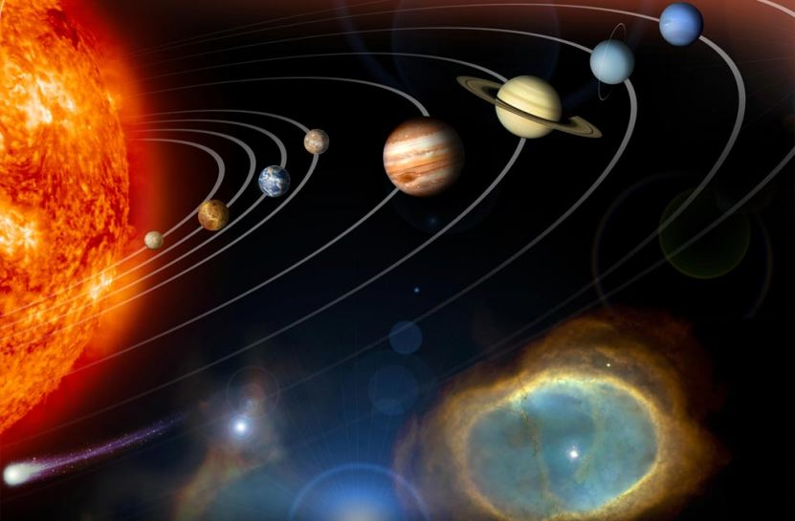
We will be covering the planets in the order they appear from the sun. Can you tell me the order of the planets?

Slide 6
THE SUN
Attention explorers, our first stop is not a planet, but an ever important star, especially for us. It is….

Slide 7
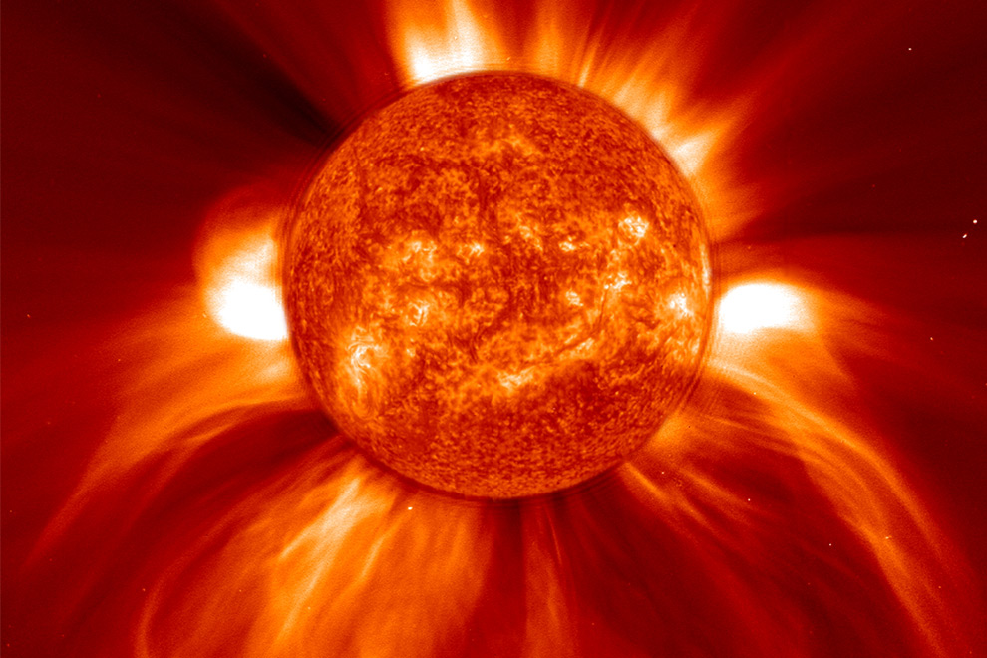
Our First Stop: The Sun
The largest star in the Milky Way.
The diameter of the Sun is 870,000 miles.
The Sun’s distance from the Earth is 93 million miles.
The Sun’s core is composed of hot & dense gasses. It has a temperature of 27 million degrees F.

Slide 8
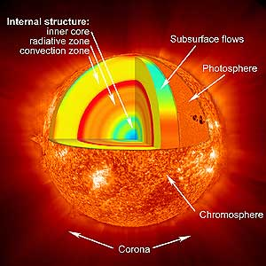

Slide 9
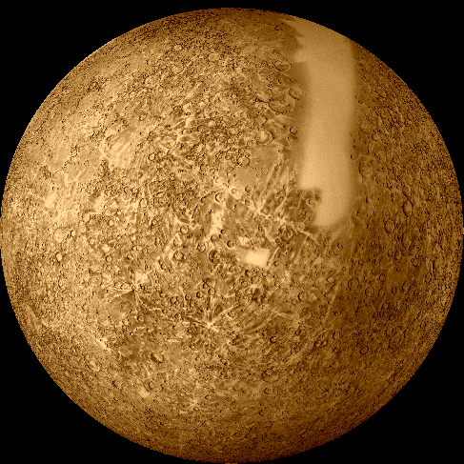
Our Next Stop: Mercury
The 8th largest star in the Solar System
The diameter of Planet Mercury is 4,878 km
Mercury’s minimum distance from Earth is 48 million miles.

Slide 10
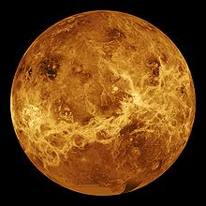
Our 3rd Stop: Venus
The sixth largest planet in the Solar System
Similar in size, density, and mass= Venus and Earth.
Maximum distance of Venus from the Sun is 68 million miles.
Minimum distance of Venus from the Earth is 25 million miles.

Slide 11
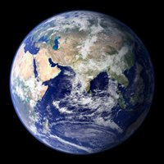
4th Stop: Earth, Planet Home
The 5th largest planet in the Solar System.
Earth’s distance from the Sun- Min. 91million miles
Max. 94.5 million miles.
The Diameter of the Earth is7,926 miles.

Slide 12
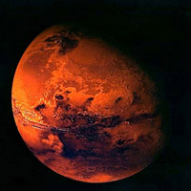
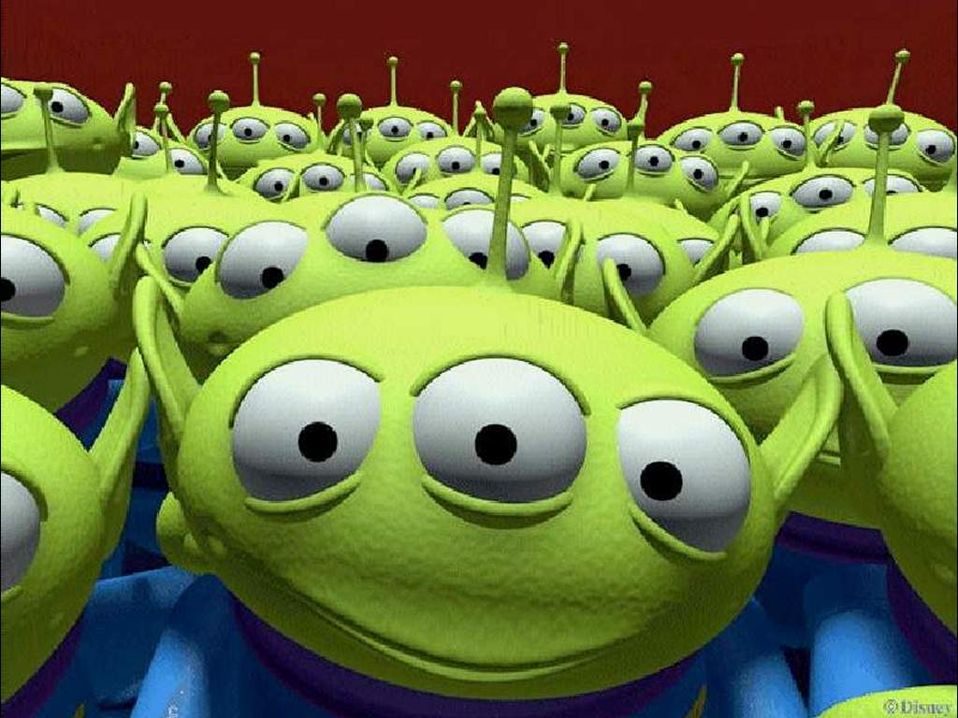
5th Stop: Mars
The Red Planet
Is it the 7th largest planet in the Solar System.
. Mars maximum distance from the Sun = 155 million miles.
Mars is 35 million miles from Earth

Slide 13
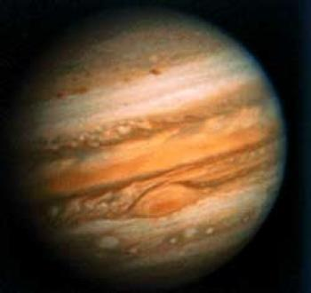
6th Stop: Jupiter
Jupiter, the largest planet in our solar system.
Jupiter’s maximum distance from the Sun = 508 million miles.
Jupiter’s minimum distance from Earth = 365 million miles.

Slide 14
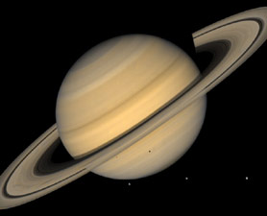
7th Stop: Saturn
The second largest planet.
Saturn’s maximum distance from the Sun is 938 million miles.
Saturn’s minimum distance from Earth is 746 million miles.

Slide 15
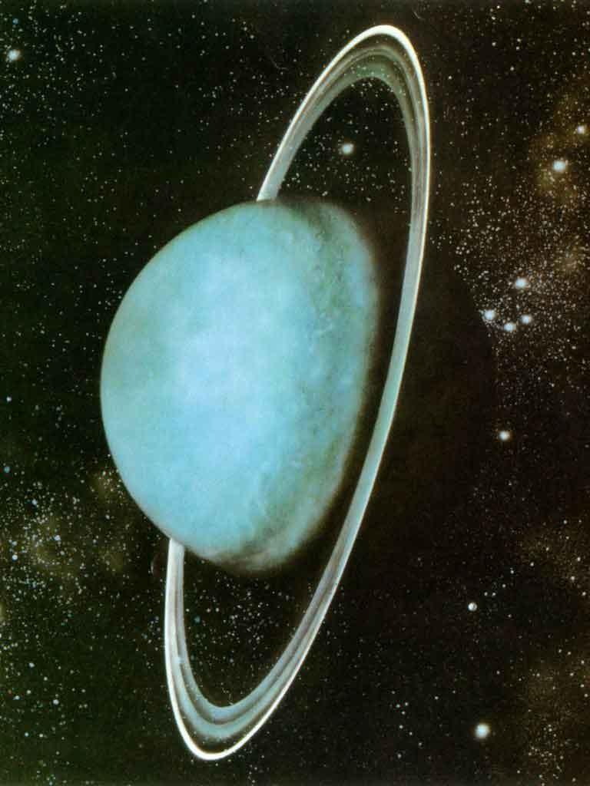
8th Stop: Uranus
Third largest planet in the solar system.
Uranus maximum distance from the Sun is 1.88 billion miles.
Uranus minimum distance from the Earth is 1.6 billion miles.

Slide 16
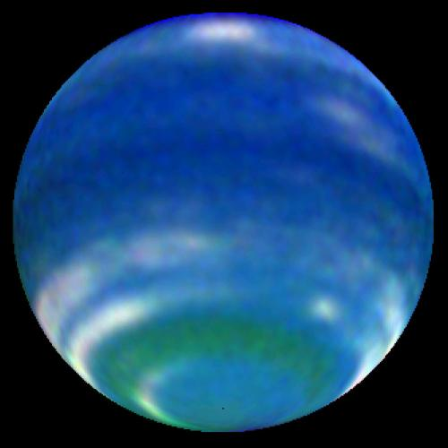
9th Stop: Neptune, the Windy Planet
The fourth largest planet in the solar system.
Neptune’s maximum distance from the Sun – 2.8 billion miles.
Neptune’s minimum distance from Earth – 2.7 billion miles.

Slide 17
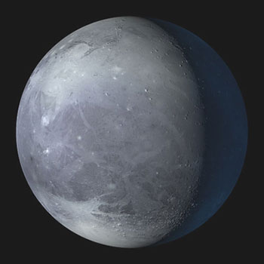
10th Stop: Pluto, the little Planet that Wasn’t
Pluto is a dwarf planet in the solar system. It is the smallest.
Pluto maximum distance from the Sun – 4.6 billion miles.
Pluto’s minimum distance from Earth –2.7 billion miles.

Slide 18
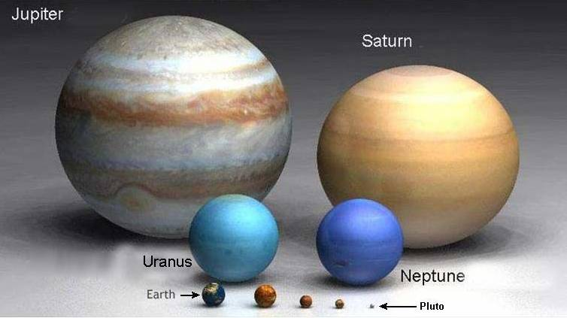
Bill Nye the Science Guy Video

Slide 19
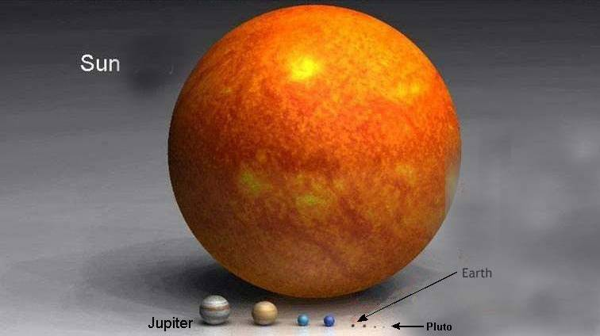
Video Planet Sizes

